Slide 1
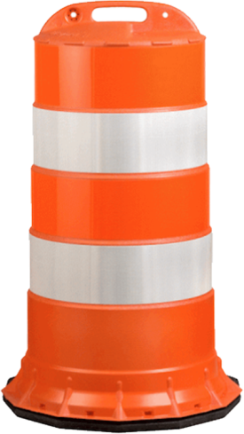
INCHES THAT MATTER,
INCHES THAT SAVE LIFE’S
HIGHWAY SAFETY IMPROVEMENT PROGRAM
Mike Vaughn, PE
KYTC
Division of Traffic Operations
Peter Overmohle, PE, PTOE
Keith R. Damron, PE
American Engineers, Inc.
Matt Simpson, PE
KYTC District 7
TEBM Project Delivery & Preservation

Slide 2
Agenda
THE PROGRAM (by Mike Vaughn)
History of KYTC’s Highway Safety Efforts
Discuss HSIP’s Roadway Departure (RD) Corridors Initiative
WHAT IS DIFFERENT (by Peter Overmohle)
Overview of HSIP Design Process
THE PROJECT (by Keith Damron)
Project Scope, Project Goals, and Focus Items
THE CONSTRUCTION (by Matt Simpson)
Explore the Construction of this on-going project

Slide 3
HSIP
“THE PROGRAM”
Mike Vaughn, PE
Division of Traffic Operations

Slide 4
Mercer County US 68
Highway Safety Improvement Program
Notes:
Inches can cause crashes even fatalities. But inches can also give Life! The HSIP program is about designing for inches. Inches that provide Success in reducing crashes, success in persons safely traveling from Point A to Point B.

Slide 5
Highway Safety Improvement Program
GOAL:
“…to achieve a significant reduction in traffic fatalities and serious injuries on all public roads through the implementation of infrastructure-related highway safety improvements.”

Slide 6
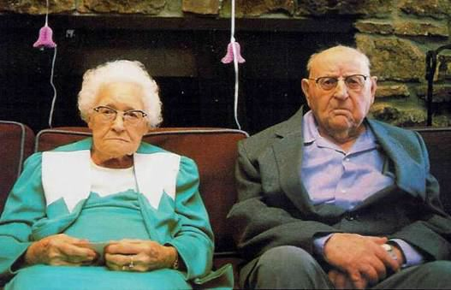
OLD WAY – HES
(Hazard Elimination System)
“Blackspots”
Large Projects
Single Location
Crashes at a Single Location
NEW WAY – HSIP
(Highway Safety Improvement Program)
Statewide Crash Types
Systemic Corridor Enhancement
Highway Safety Manual
Strategic Highway Safety Plan

Slide 7
Why alter business practices?
We had Successful HES Projects
But…Fatalities & Serious Injuries were still rising:
To put it simply: WE WERE NOT MEETING OUR GOAL

Slide 8
Effect of HSIP
Began Transition to HSIP in late 2005

Slide 9
Crash locations are random !!

Slide 10
Crash types are predictable!!

Slide 11
Crash Analysis (2009-2014)
 | 2009 | 2010 | 2011 | 2012 | 2013 | 2014
Total Fatalities | 791 | 760 | 720 | 746 | 638 | 672
Roadway Departure Fatalities | 575 (72.7%) | 530 (69.7%) | 514 (71.3%) | 556 (74.5%) | 432 (67.7%) | 454 (67.6%)

Slide 12
Roadway Departure Solutions
1
Keep Vehicle on Road
2
Safe Recovery
3
Reduce Severity

Slide 13
Low Cost RD Countermeasures
Center Line Rumble Strips (CLRS)
Edge Line Rumble Strips (ELRS)
Shoulder Rumble Strips (SRS)
High Friction Surface Treatment
Safety Edge or Pavement Wedge
Shouldering and Slope Flattening
Cable Median Barrier
Tree Removal / Clear Zone Improvements
New Guardrail & Guardrail Upgrades/Replacement
Enhanced Signing for Curves
Superelevation Improvements
Pavement Markings

Slide 14
HSIP Investment Plan
Annual HSIP Allocation ≈ $38.4 Million
Funds Divided into
13 Initiatives
Initiatives are Grouped into 3 Main Categories:
Roadway Departure
Intersections
Other Initiatives
Mercer US 68 originated from the RD category

Slide 15
Roadway Departure Initiatives
Total = $25.4 Million
Mercer US 68 originated
from the RD Corridors initiative

Slide 16
Roadway Departure Corridors Initiative
Target rural, two lane, high speed (50 MPH and greater) facilities
Corridors typically range between 4-10 miles
1 project per District per year
Funding Guidelines per Project:
Approx. $250,000 for Design
$1 Million - $1.5 Million for Construction
Construction costs are typically $200,000 per mile or less

Slide 17
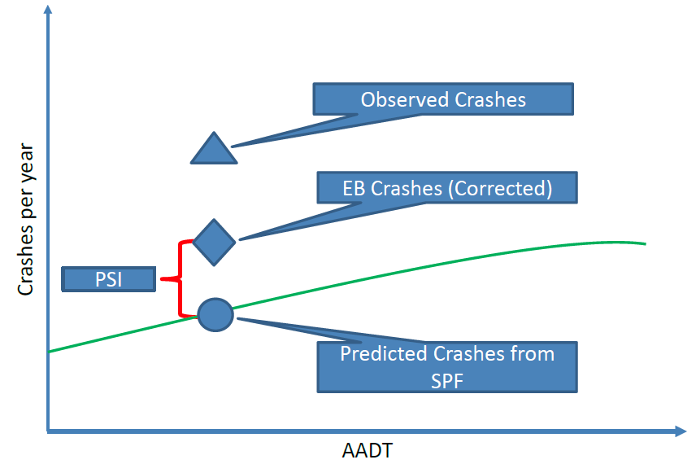
Project Selection
Use SPF (Safety Performance Function) and EB (Empirical Bayes) Analysis to identify and prioritize potential projects
SPF
PCR
PCR = Potential Crash
Reduction

Slide 18
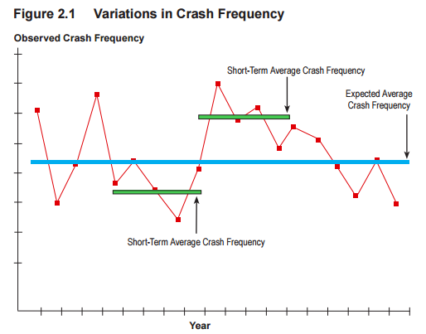
Network Regression to the Mean

Slide 19
Example Analysis
Example Statewide Spreadsheet: (Full Spreadsheet has nearly 4,000 rows)

Slide 20
Example Analysis / Selection
Example “Short List”:
District | County | Route | BEGIN MP | END MP | Length | AADT | Expected Crashes Per Year | EB Estimate | PCR All Crashes
13 | I | Route 1 | 21 | 27 | 6 | 6000 | 62.22 | 117.27 | 55.06
13 | B | Route 2 | 6 | 11 | 5 | 4900 | 42.24 | 61.45 | 19.22
13 | D | Route 3 | 0 | 3 | 3 | 5800 | 28.70 | 43.25 | 14.55
13 | H | Route 4 | 0 | 12 | 12 | 3000 | 65.88 | 79.37 | 13.49
13 | H | Route 5 | 0 | 7 | 7 | 900 | 15.90 | 29.18 | 13.29
13 | H | Route 6 | 0 | 6 | 6 | 1500 | 18.62 | 25.32 | 6.70
13 | G | Route 7 | 7 | 12 | 5 | 850 | 10.07 | 16.68 | 6.61
13 | H | Route 8 | 0 | 3 | 3 | 7200 | 14.27 | 19.80 | 5.53
13 | B | Route 9 | 1 | 8 | 7 | 1200 | 18.16 | 23.53 | 5.37
13 | G | Route 10 | 12 | 16 | 4 | 1700 | 12.99 | 17.84 | 4.84

Slide 21
HSIP
“What’s Different in the Design Process?”
Peter Overmohle, PE, PTOE
American Engineers, Inc.

Slide 22
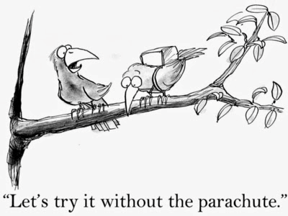
Not Part of HSIP Program
Traditional Design Process & Development

Slide 23
NOT Part of HSIP Program
Production Hour Items
Surveying (limited)
DTM (corridor mapping not available)
X-Sections only where surveyed
Traditional plan sheets
Structural Design
Geotechnical Exploration
DES
Public Meetings
ROW Plans / Deeds
Final Plans Review
Plans do not go through Plan Processing procedure

Slide 24
HSIP Design Process
A Non-Traditional Way
Inventory and assess existing conditions (may include surveying)
Explore and evaluate possible countermeasures (within existing ROW & without disturbing utilities)
Determine cost estimates for countermeasures
Analyze Crash Data (helps prioritize improvements)

Slide 25
HSIP Design Process
Roadway Departure Countermeasures:
Widen and pave shoulders (to obtain up to 4’ final paved shoulder width)
Add rumble strips
Superelevation Improvements
Flatten Roadside Slopes
Culvert Extensions / Safety Headwalls / Drop Boxes
Ditching and Shouldering
Improve Signing and Delineation

Slide 26
Crash Data Analysis

Slide 27
HSIP Design Process
A Non-Traditional Way
Provide a Design that Improves the Corridor
Design guidelines are more likely used as a guide
Exceptions are normal
Notes are more general, giving the resident engineer more flexibility in the exact locations for improvements
Improvements are made to match funds

Slide 28
HSIP Design Process
A Non-Traditional Way
Plan Development and Deliverable:
Survey specific features only
X-sections at critical locations (curves / pipes)
Guardrail
Utilities above ground and level D only
Utilities Noted on plans (Burden on Contractor)
Final Design Using Geotech Overview (if any geotech)
(Hybrid Design) Large scale ( 1”=100’ or 200’) plan sheets

Slide 29
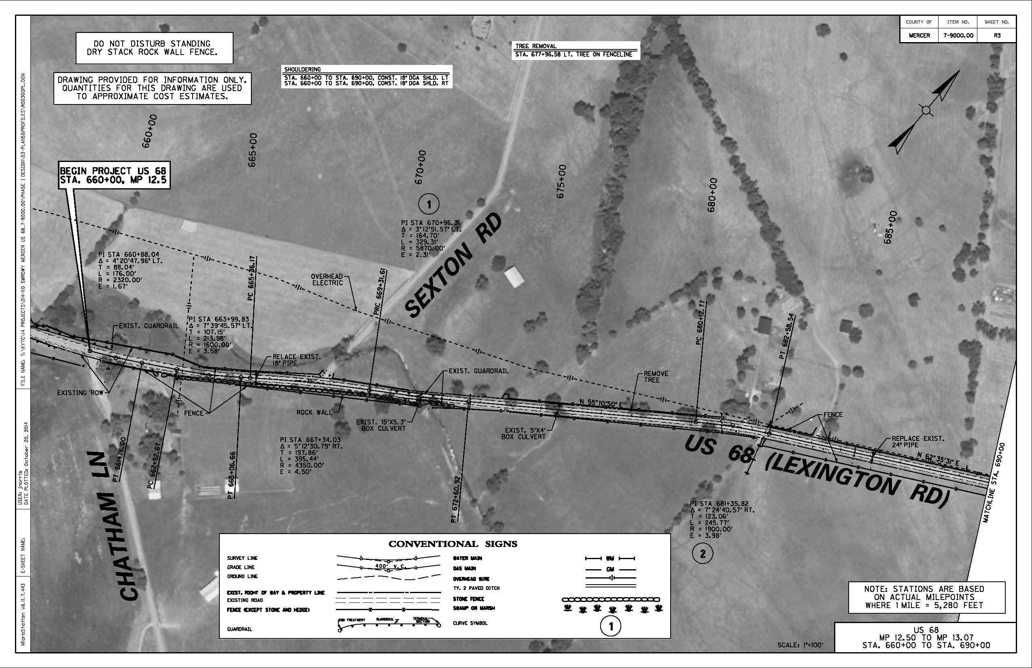
Typical Plan Sheet

Slide 30
HSIP Design Process
A Non-Traditional Way
Plan Development and Deliverable (cont.):
Right of Way, if any, consist mostly of a Right of Entry
Construction Proposal
Mostly notes and spreadsheets
Quantities
Developed from limited X-Sections and Aerial Photos

Slide 31
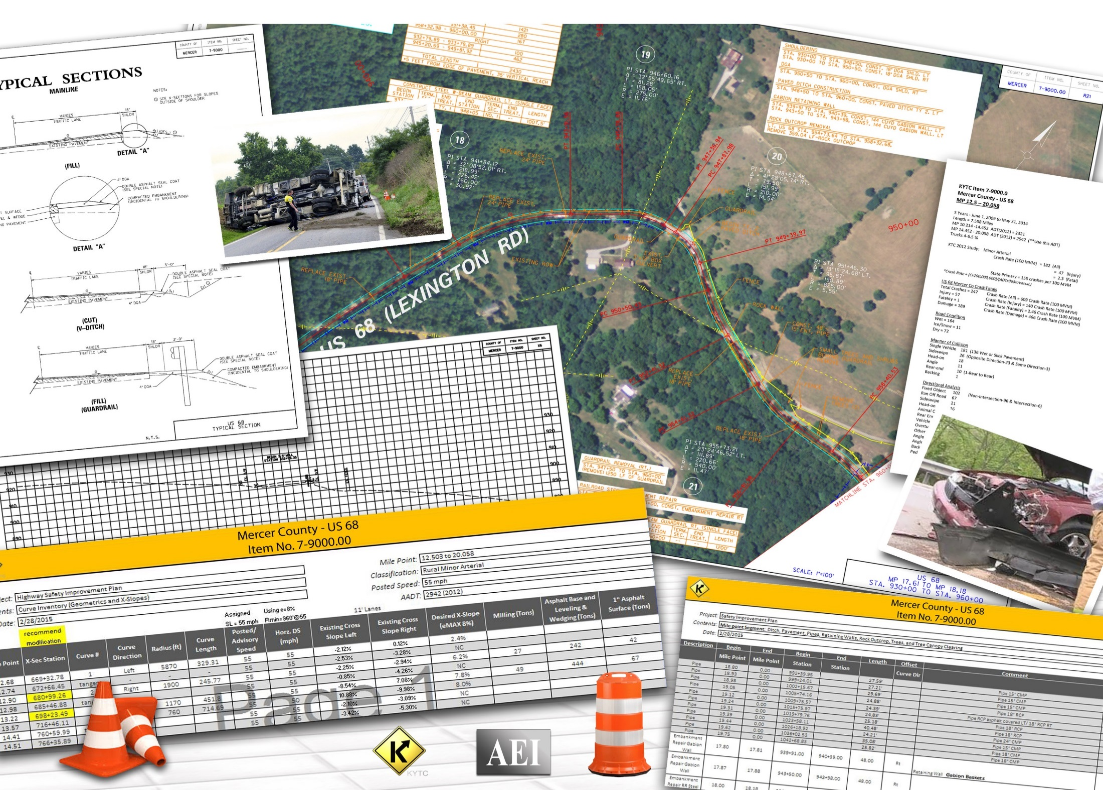

Slide 32
HSIP
“THE PROJECT”
Keith Damron, PE
American Engineers, Inc.

Slide 33
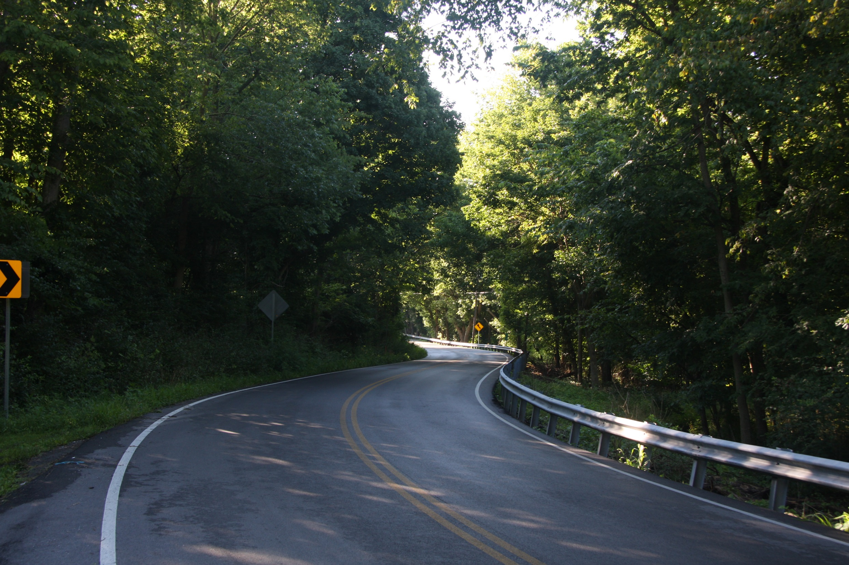
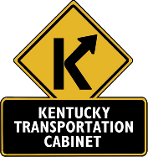
US 68 Mercer County
MP 12.5-20.058
$3.1 Million
(Notice To Proceed - July 2014)
Construction Letting – Nov 2014
Notes:
US 68 in Mercer Co is an ideal example of benefiting from the HSIP program concept using a non-traditional design. This 7.5 Mile, $3.1 Million project had an aggressive 4 month design schedule in order to make the November 2014 Letting. To meet this schedule we designed for Inches not standards.

Slide 34
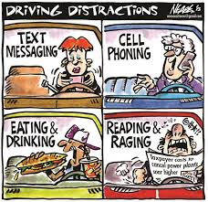
Notes:
Success starts by understanding who our drivers are. Drivers have become accustom to certain expectations in how a road performs. Drivers expect roads to be were they expect them to be and are often inattentive as a result. This reminds me of the crash report I read several years ago, “I was going around the curve and the pole came out of no where!!!”

Slide 35
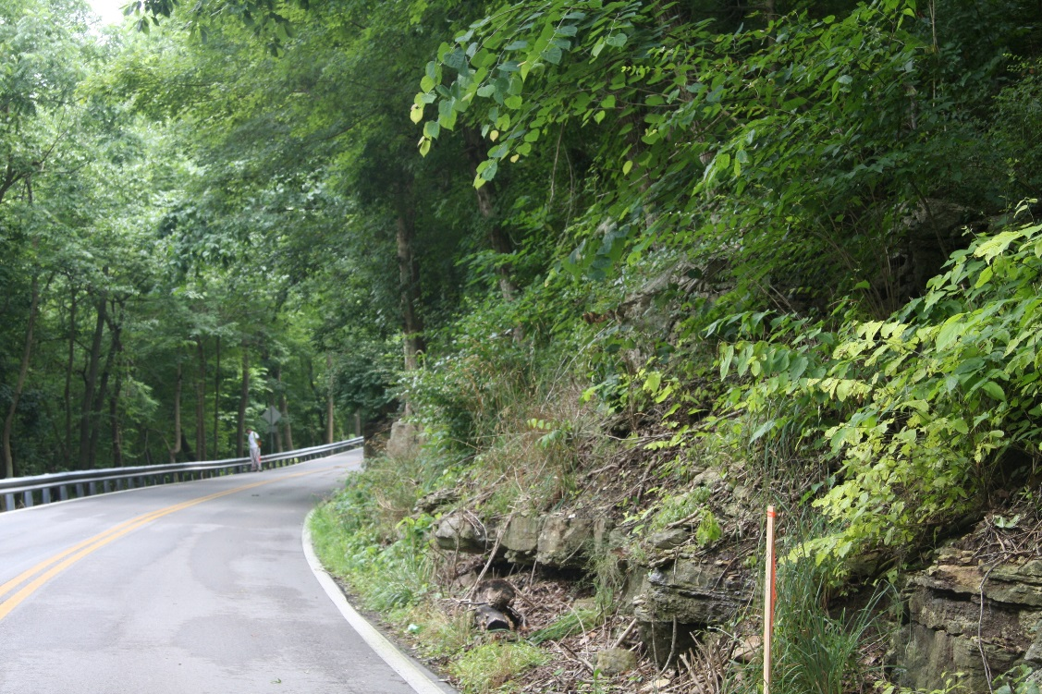
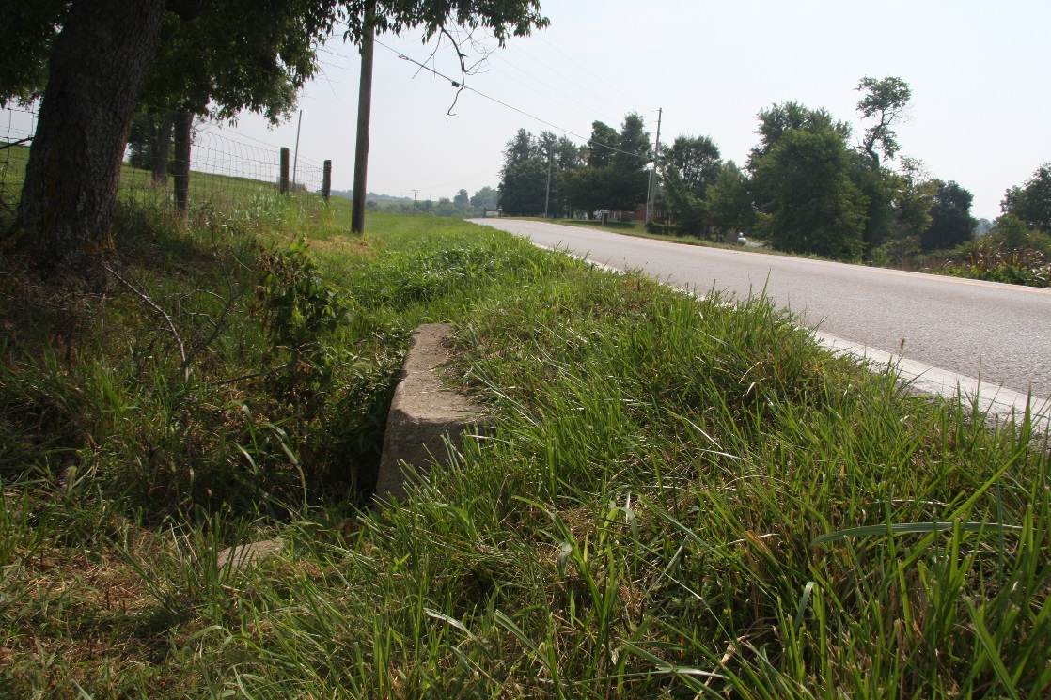
Project
Scope
Improve Safety
Notes:
The US 68 project scope was set with one main purpose, which is to make improvements on the existing roadway in an effort to reduce crashes, and improve safety.

Slide 36
Project Goals
Data Driven
Meet the November Letting
Stay within Right of Way or Possibly Easements
Notes:
The project had 3 primary goals: 1. Improving safety through a data driven approach in identifying the needs.
2. Make the November Letting in order to provide the traveling public benefits ASAP.
3. To stay within the existing ROW which was crucial in order to make the November Letting. We had no proof of ROW other than one plan sheet showing 20’ from center. So we used 40’ unless their was a fence or stacked rock fence within the 20’ then we used less. Do you know how hard it is to provide improvements and stay within a 40’ ROW or sometimes less???

Slide 37
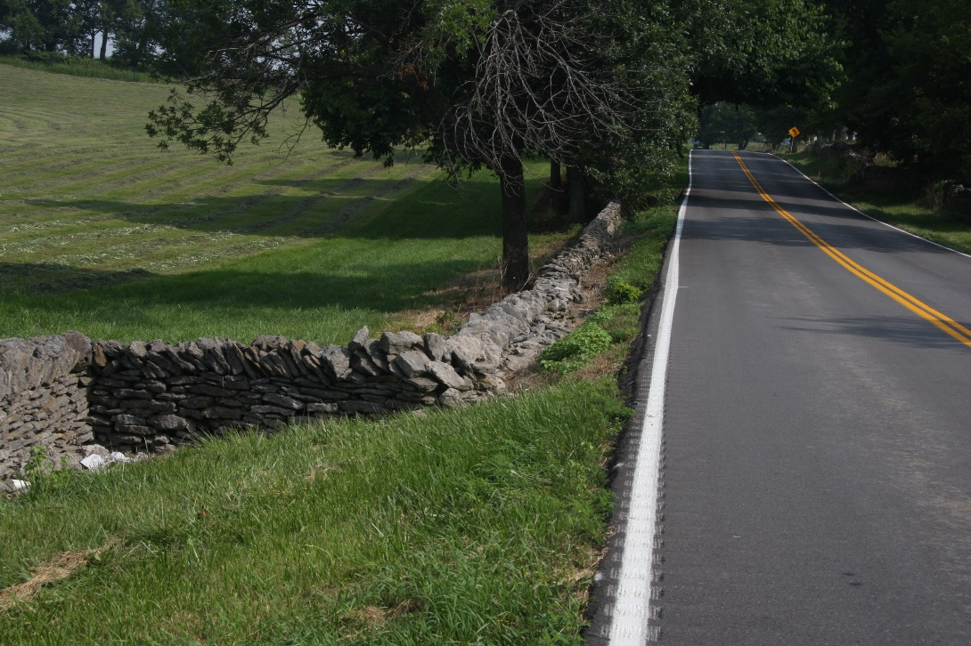
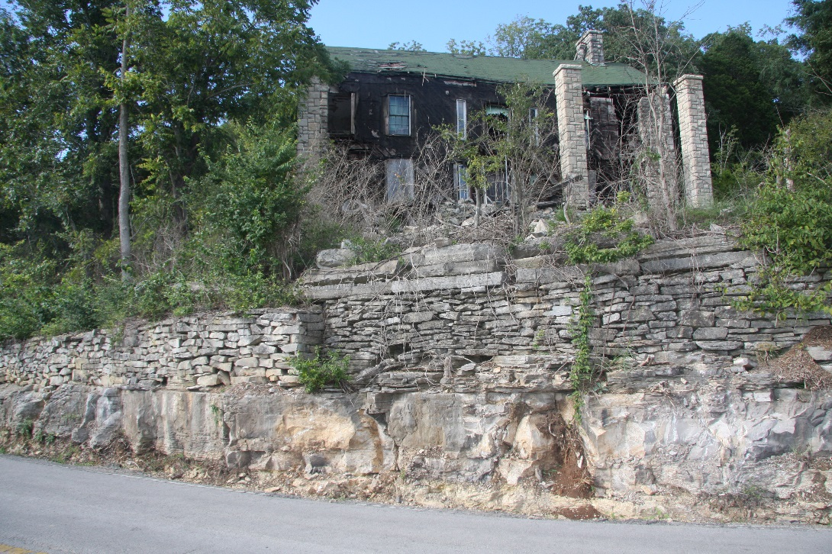
US 68 – The HSIP DESIGN
Environmental by KYTC.
Utilities.
No Easements.
Notes:
Environmental was conducted in house by KYTC.
Utilities coordination occurred in order to show them on Aerial Plans.
The Decision during design was to also have no easements.

Slide 38
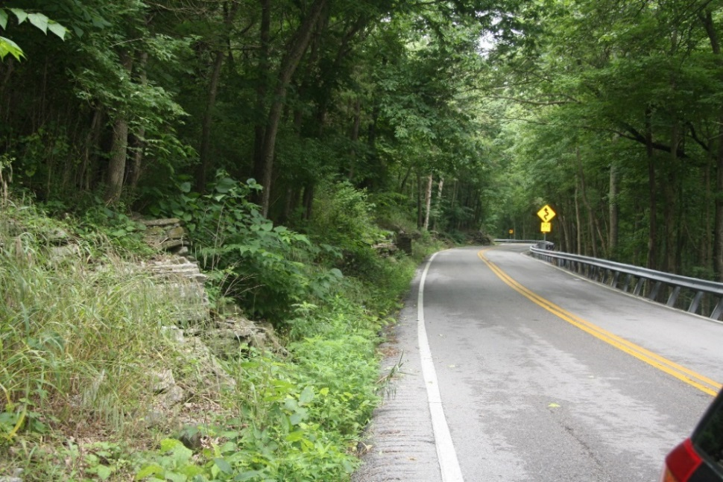
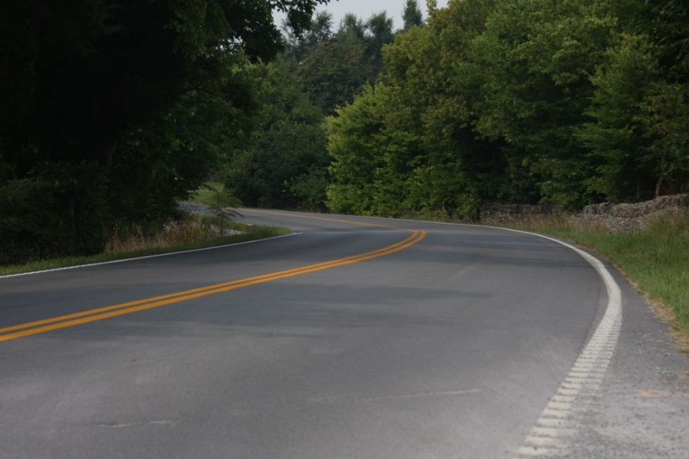
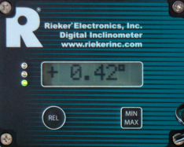
Road Safety Audit
Field Reconnaissance
Field Inspection
Inventory Curve Safe Speed (Digital Ball Bank Indicator)
Notes:
As Field Reconnaissance began by obtaining survey and Lidar information, we also conducted a Road Safety Audit. We identify items of potential concern. Curves were inventoried using a digital ball bank indicator to help begin to identify curves that could and should be improved and those that are acceptable as they are,

Slide 39
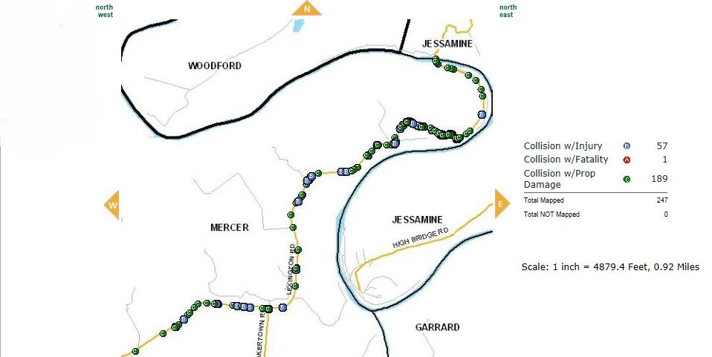
Road Safety Audit
Crash & HIS collection
Manner of Collision
Single Vehicle 181
Sideswipe 26 (Opposite Direction-23 & Same Direction-3)
Head-on 18
Angle 11
Rear-end 10 (1-Rear to Rear)
Backing 1
Road Condition
Wet = 164
Ice/Snow = 11
Dry = 72
Notes:
The road safety audit included a deep dive into the crash data and the KYTC Highway Information System data.
A 5 years analysis revealed 247 crashes occurring along this road segment. Single Vehicles Collisions was the primary manner of collision, accounting for 73% of the crashes in this road segment.

Slide 40
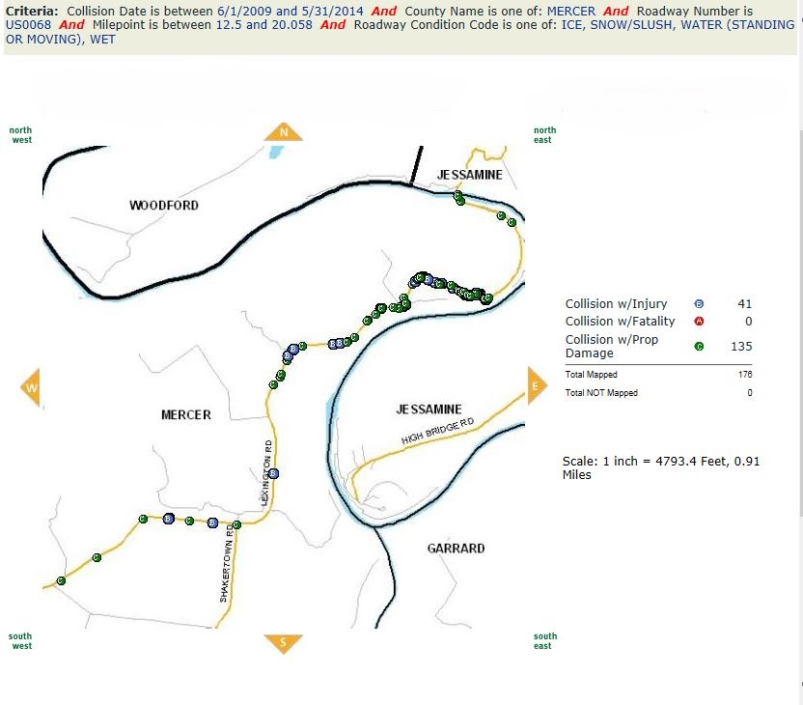
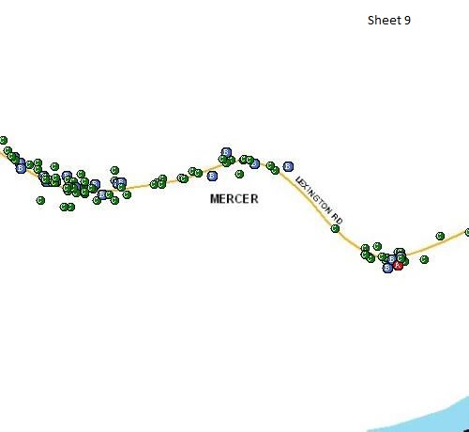
Total Crashes: Wet and Slick Surface
Notes:
Further analyzing the data for specific patterns and spot locations with high crashes, we learned that slick surfaces accounted for 175 (71%) of the crashes. A large majority were located in the area of the mountainous, winding roadway segment to the Kentucky River.

Slide 41
12 Focus Items
Ditching
Shouldering
Guardrail
Drop Box Inlets
Tree Removal
Tree Canopy Clearing
Rock Out Crop Removal
Super Elevation
High Friction Surface
Pipe Extension
Pipe Replacement
Embankment Failure
Notes:
From data collected, these 12 primary focus items for improvements were identified that could reduce crashes, improving safety.
Ditching - Working with ROW constraints, we looked at reestablishing some degree of ditching with a few defined inches of width and depth.
Shouldering - To help prevent crashes from road drop-off’s, we are improving the shoulders by a few inches with side slopes of to 3:1.
Guardrails were substandard by just a few inches.
As part of the outcome of improving ditches and shoulders, is the extending or replacement of cross drains to add a few more inches of length in with appropriate safety boxes when ROW allowed a sufficient width to do so.
DBI such as this type 13 or a modified DBI are part of the project.
Obstacle trees, especially those on the outside of curves and within 5’ of the edge of the are to be removed.
The tree canopy removal is one of the main scopes of this project is to try to open up the segment of road on the hill to more light by removing some of the tree canopy to help in drying the road after dew or periods of wet or slick conditions.
Rock Outcrop - There are several locations on the hill where rock outcrop crowds the road as well as prevent ditching.
Embankment Failure –
The last 2 main items consist of Super elevation up to a maximum of 8%. However, because of ROW constraints, most areas received super elevation improvements less than 8%. But even a few inches of pavement to improve the super with appropriate signing will better meet driver expectations.
High Friction Surface - 30 days after the installation of the new asphalt pavement High Friction surface is to be installed on all curves with advisory speeds less than 25 MPH.

Slide 42
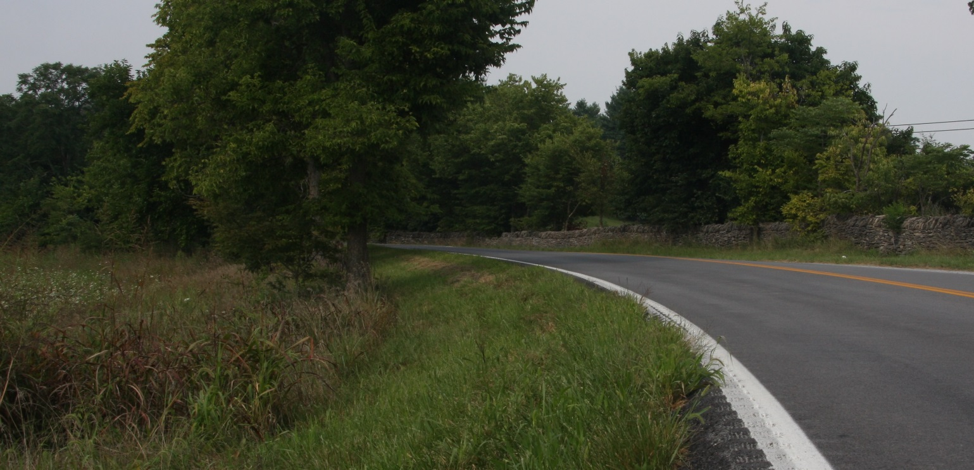
Project Improvements
Super Elevation
High Friction Surface
Notes:
Superevalation were redesigned. The goal was an 8% super, but ROW constraints, often resulted in a lesser %, but yet provided an improvement compared to the existing reverse super such as shown in this photo.
Slick surfaces are being addressed by installing a High Friction Asphalt in several curves.
Matt will talk more of the other focus items in a minute.

Slide 43
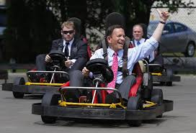
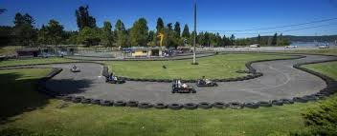
What We Want!
Notes:
But remember, that how we would like to design US 68 for ultimate safety in keeping cars from being able to crash or go off the road through a total reconstruction project in comparison to using the available safety funding to make immediate improvements by reducing crashes on US 68 is different.

Slide 44
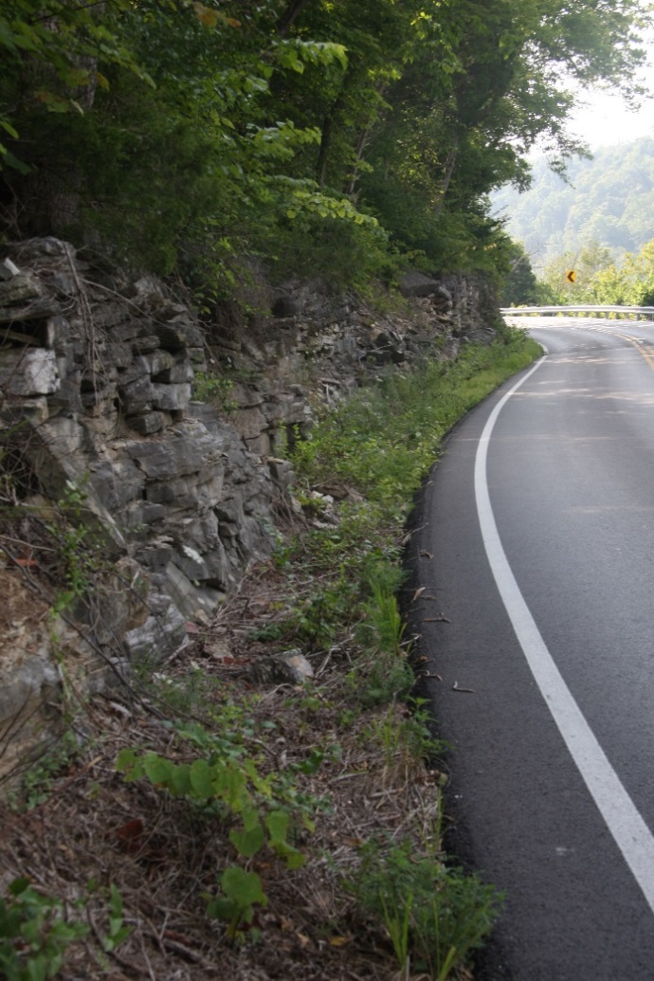
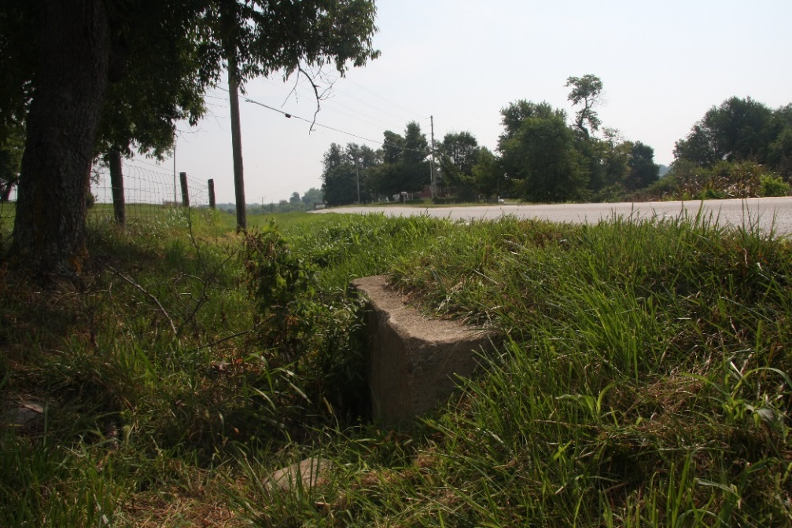
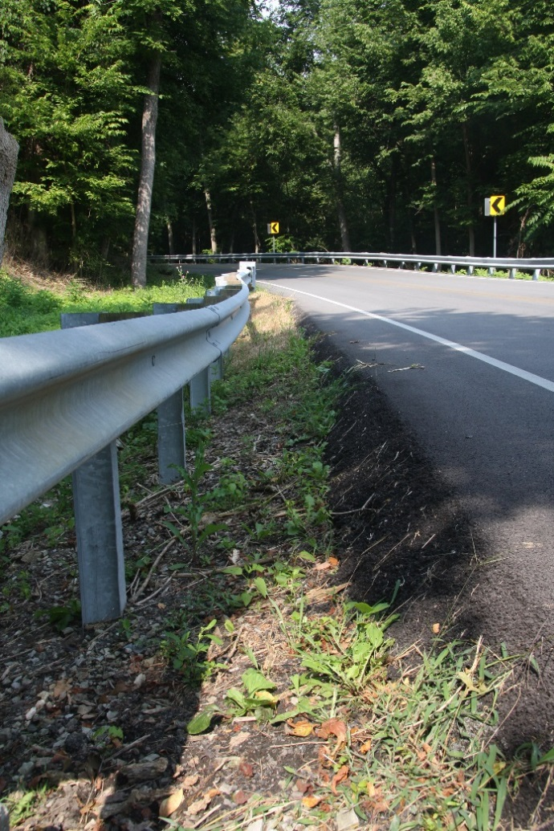
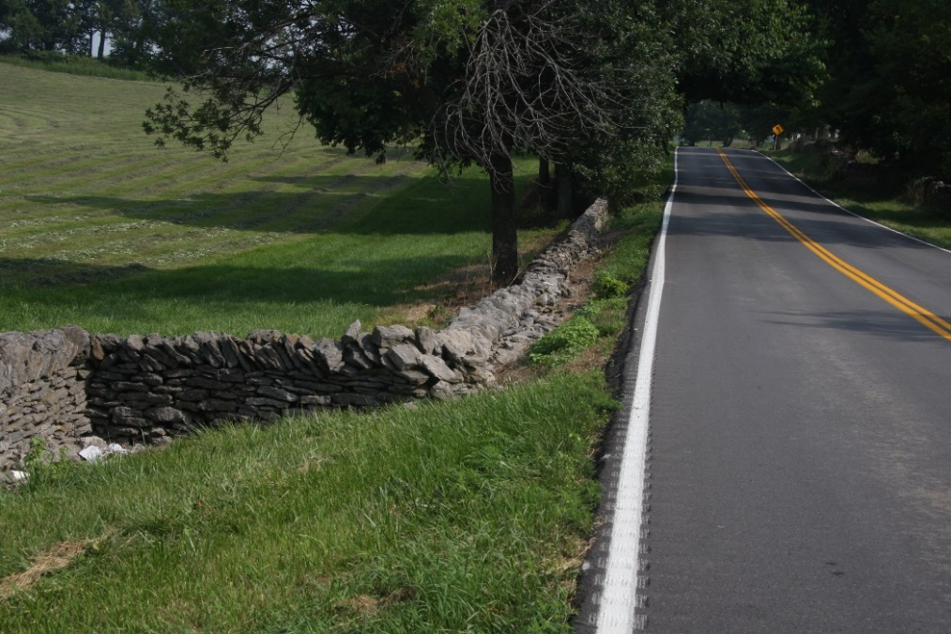
What
We Have!
Notes:
While ultimately US 68 still needs to stay in the KYTC focus for a much larger reconstruction project, the HSIP program designs are about providing immediate short term improvements while not totally eliminating the existing situations.
If US 68 had a steep curve before, then it will still have a steep curve after the HSIP project is completed. The difference is the road will better meet the expectations of the motorists, therefore improving safety.

Slide 45
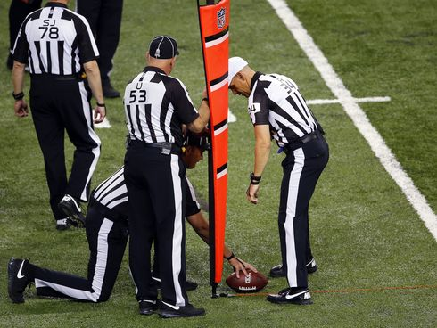
Inch by Inch,
Life’s a Cinch!
Yard by Yard,
Life is Hard!
By: John Bytheway
Notes:
Has anyone in this room every worked on a large project, that experienced years of delays waiting for funds???
I have. While big projects are good, and in no means do I want to mislead that we should settle for smaller quick wins, but often we can make significant safety improvements of existing conditions on our roads by not going after the first down or touchdown all at once, but taking what inches we can get to improve our roadways.
Inches added to provide a shoulder or eliminate a shoulder drop off; inches of asphalt added to improve super elevation; inches that guardrail is raised to meet standards.
Once Inch at a time, we can save life’s!

Slide 46
HSIP
“THE CONSTRUCTION”
Matt Simpson, PE
KYTC District 7
TEBM for Project Delivery and Preservation

Slide 47
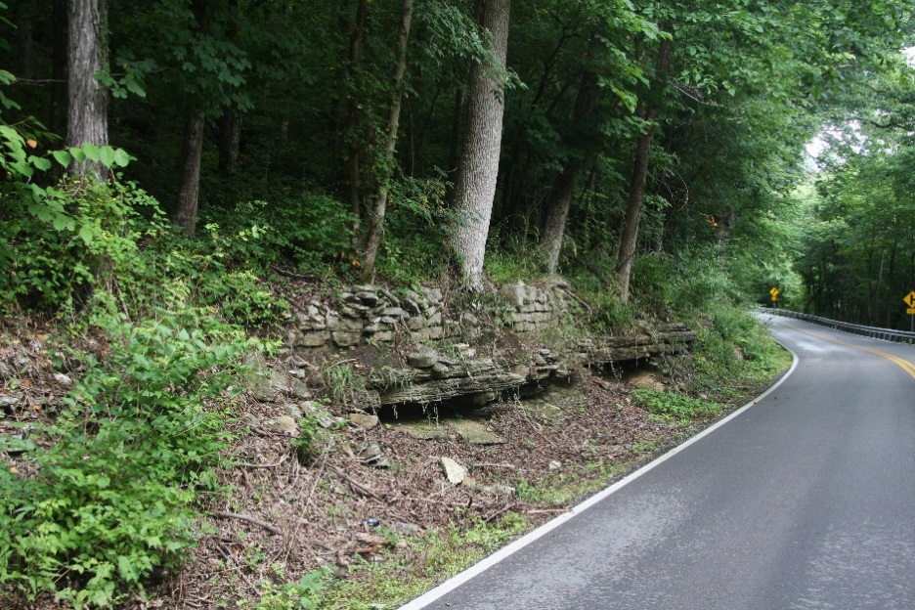
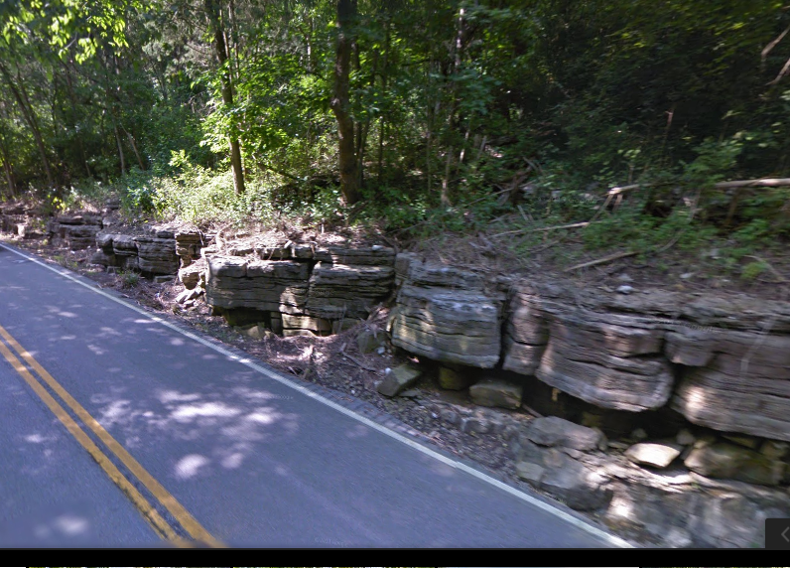
Project Improvements
Before
1. Ditching
Notes:
A paved ditch is being installed by removing some of the rock slope with a hoe ram.

Slide 48
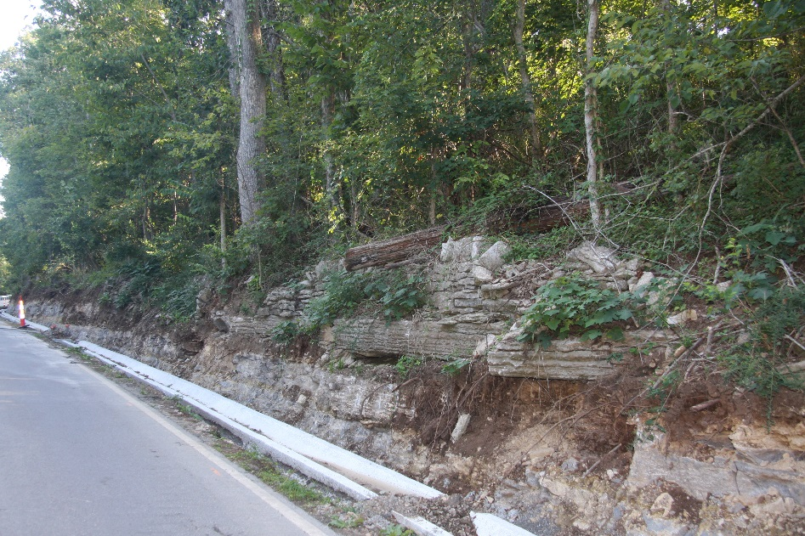
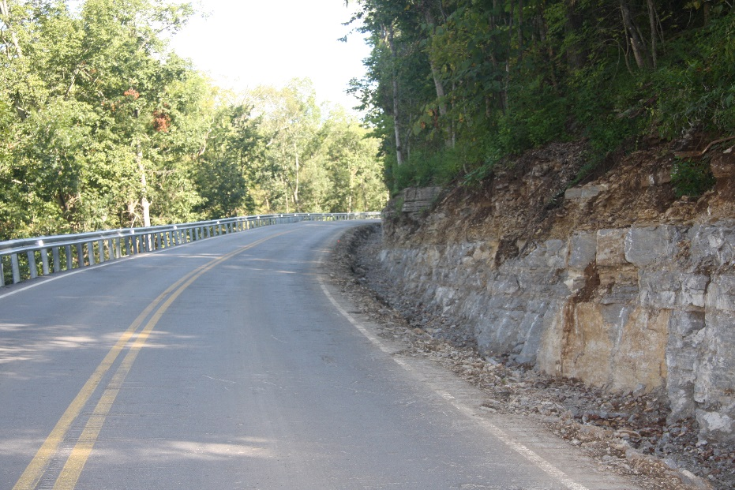
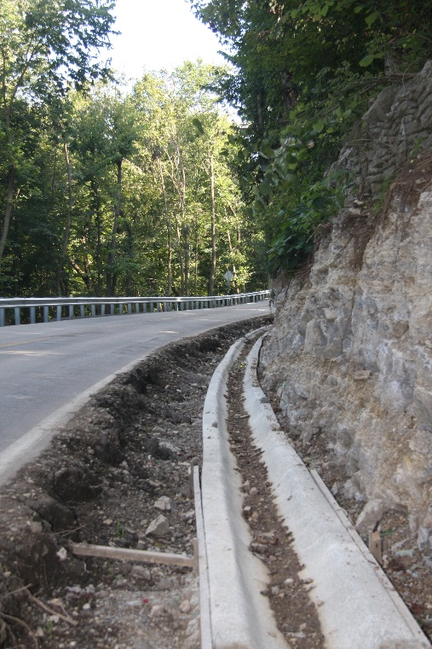
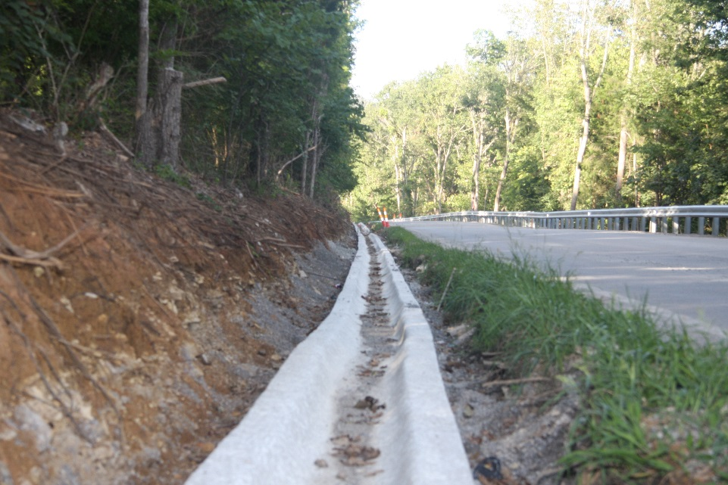
Project Improvements
Sample Text
1. Ditching
Notes:
Additional phots of ditching.

Slide 49
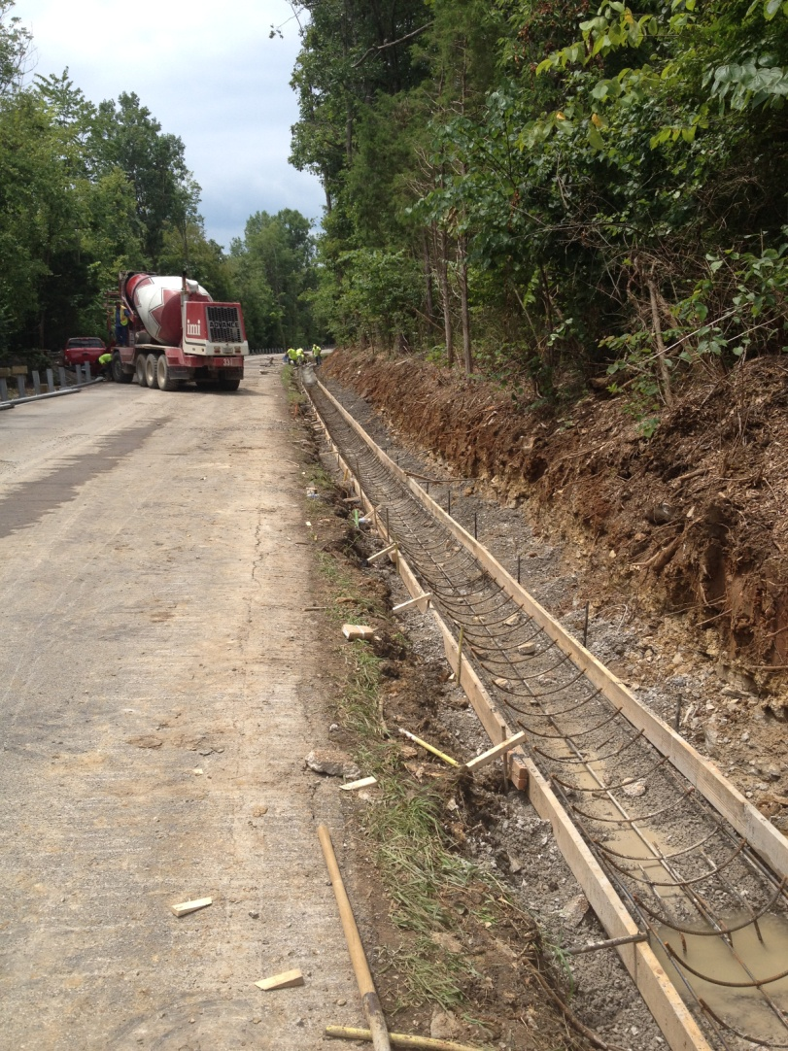
Project Improvements
1. Ditching
Notes:
Additional phots of ditching.

Slide 50
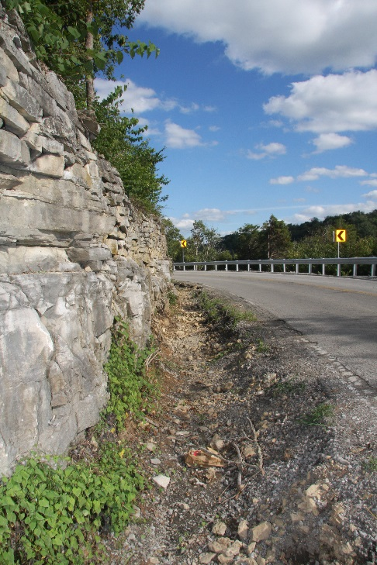
Project Improvements
2. Rock Outcrop Removal
After
Before
Before
After
Notes:
Rock Outcrop - Using a hole ram, some rock outcrop is being removed to allow for shoulder. Even though ROW constraints, there is room to make some improvements by laying the hill back by a few inches.

Slide 51
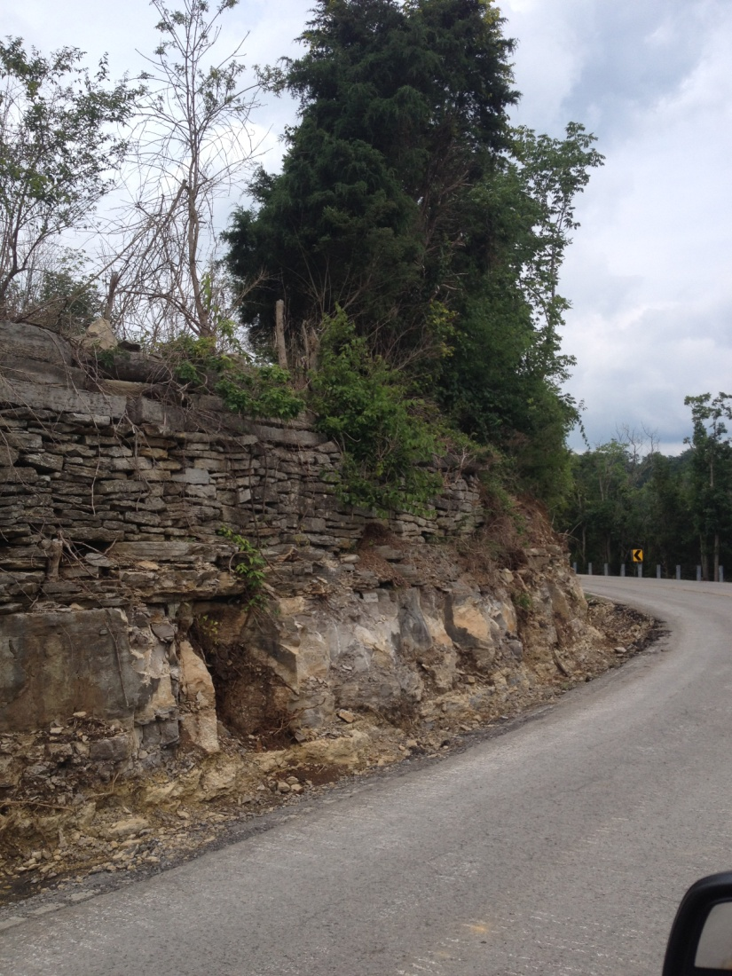
Project Improvements
2. Rock Outcrop Removal
Notes:
Rock Outcrop - Using a hole ram, some rock outcrop is being removed to allow for shoulder. Even though ROW constraints, there is room to make some improvements by laying the hill back by a few inches.

Slide 52
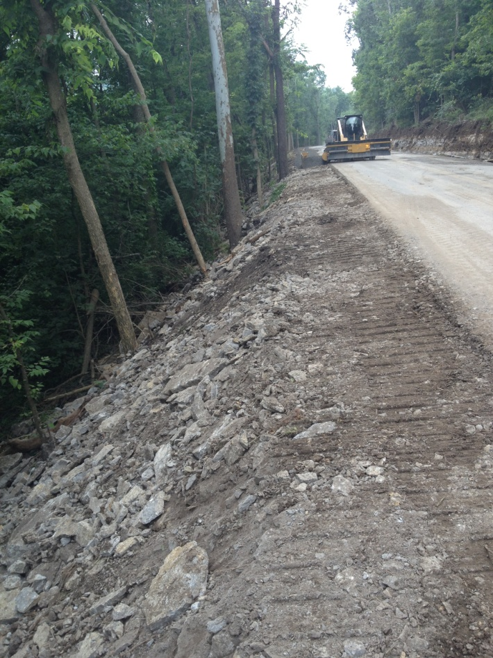
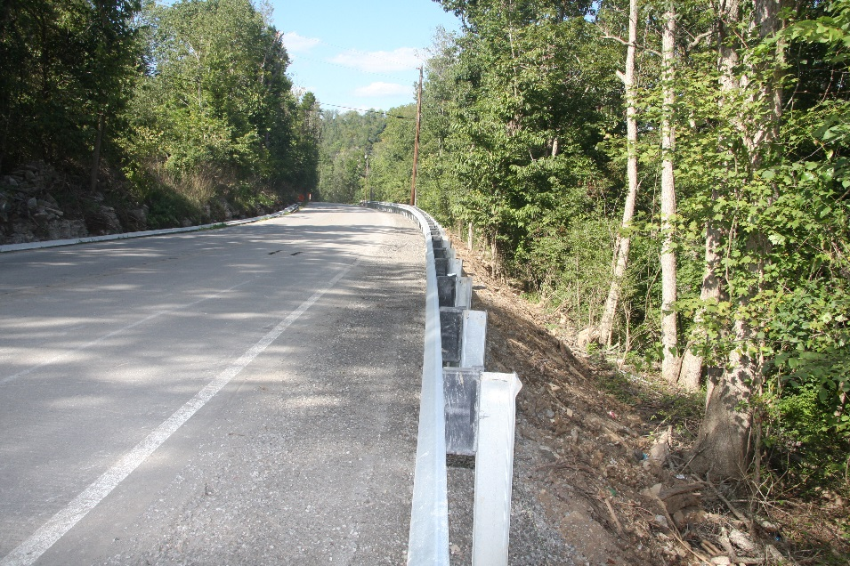
Project Improvements
3. Shouldering
Notes:
Shouldering – We are raising a minimum of 18” of shoulders through to a minimum of 3:1 slopes where possible.

Slide 53
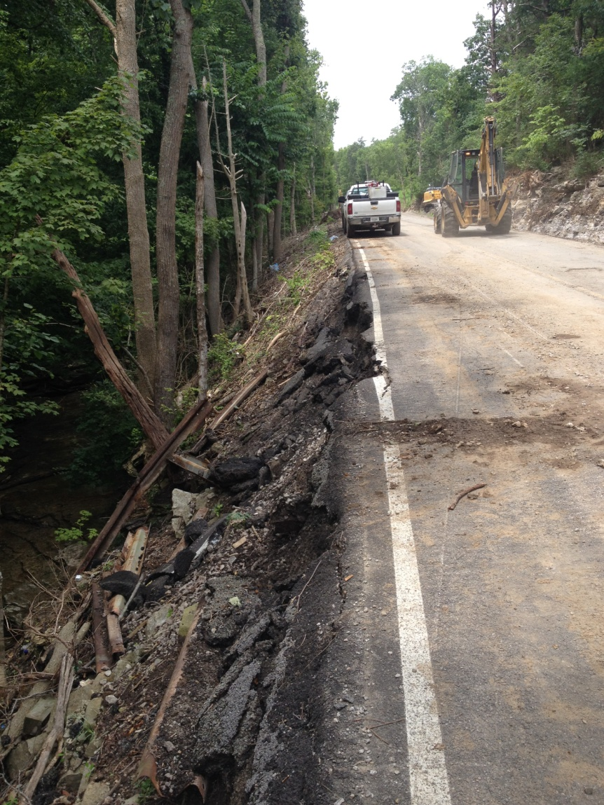
Project Improvements
Before
Before
3. Shouldering
Notes:
Shouldering – We are raising a minimum of 18” of shoulders through to a minimum of 3:1 slopes where possible.

Slide 54
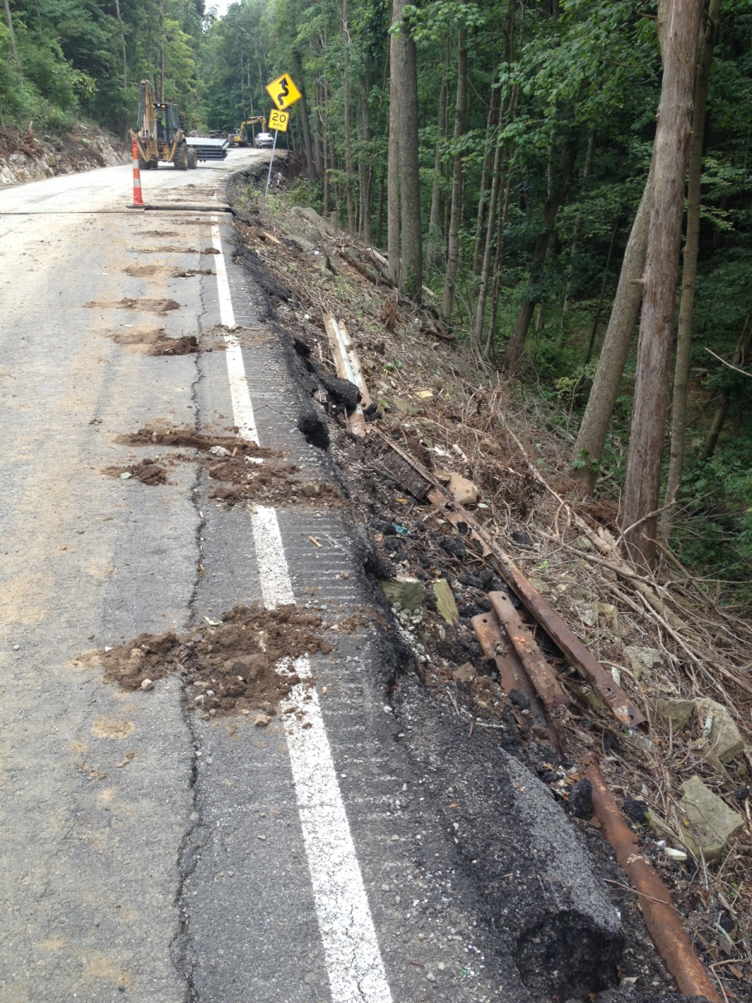
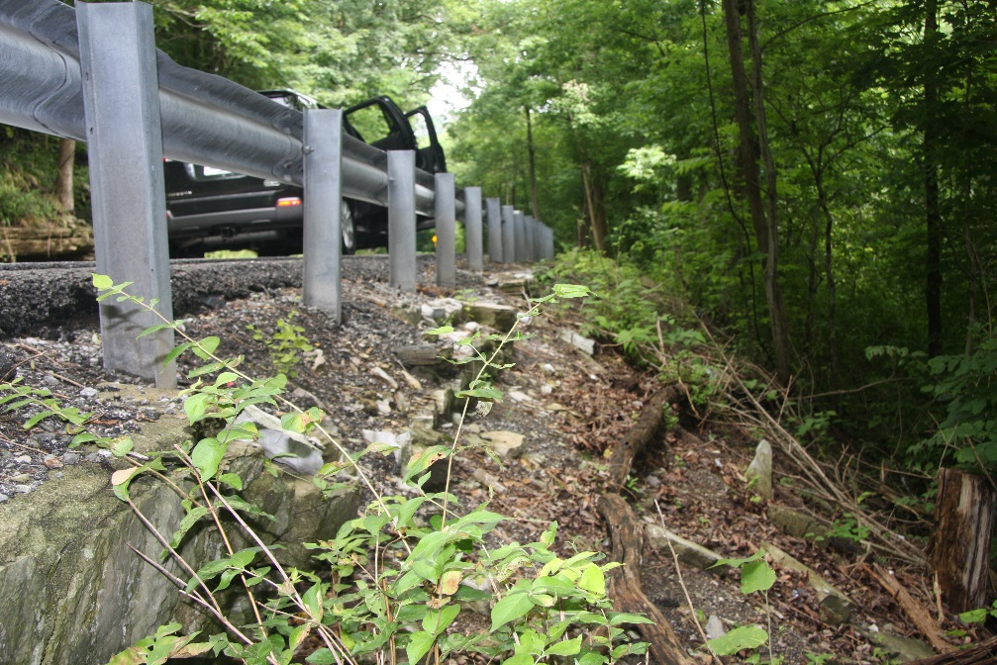
Project Improvements
4. Retaining Wall for
Embankment Failure
Notes:
Embankment Failure –US 68 had several segments with embankment failures that caused the guardrail to lay back away from the road and allowing for deep drop-off’s. Using drilled railroad steel and cribbing, this areas are being repaired and will include the 18” shoulder.

Slide 55
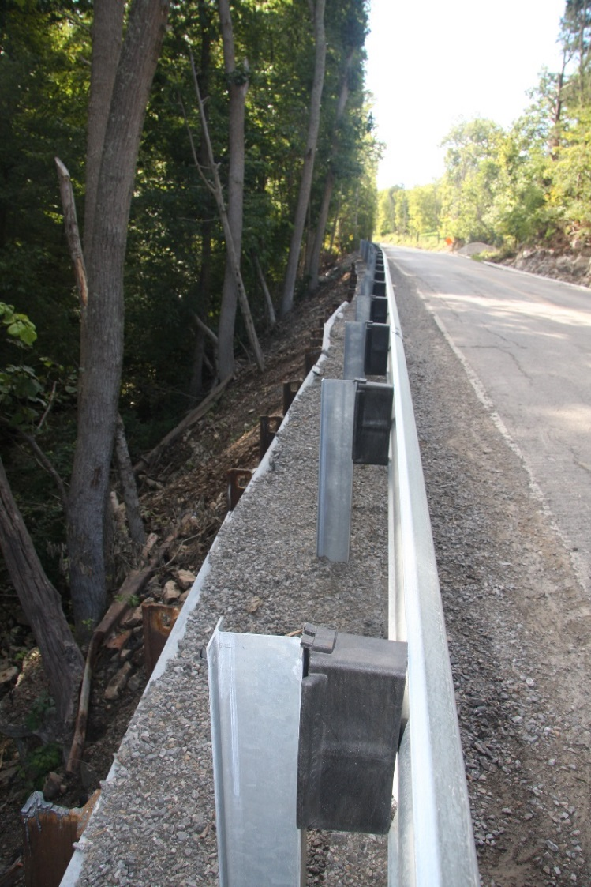
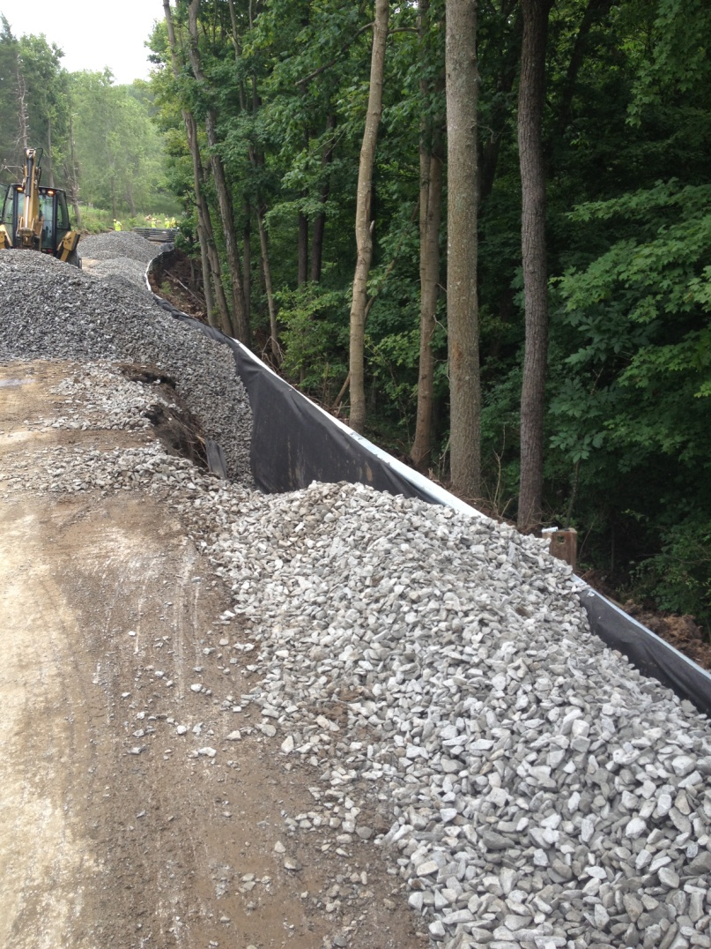
Project Improvements
4. Retaining Walls
Notes:
Embankment Failure –US 68 had several segments with embankment failures that caused the guardrail to lay back away from the road and allowing for deep drop-off’s. Using drilled railroad steel and cribbing, this areas are being repaired and will include the 18” shoulder. In many areas we were able to add considerably more than the 18” shoulder.

Slide 56
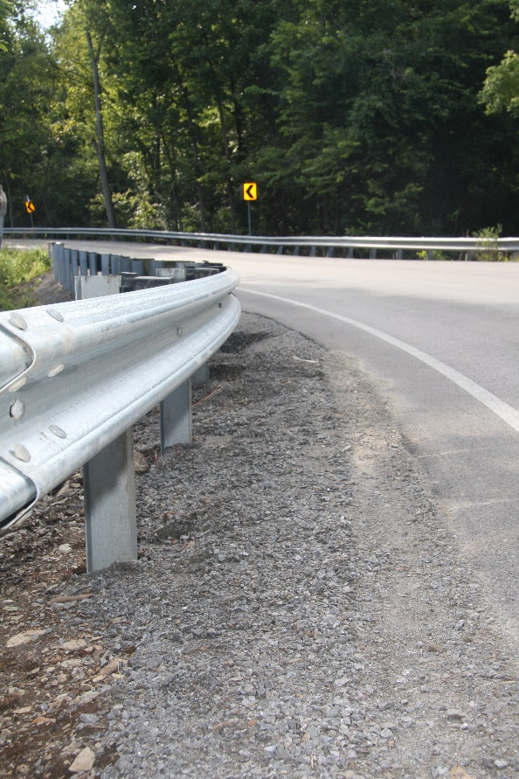
Project Improvements
Before
After
5. Guardrail Improvement
Notes:
Guardrails were substandard by just a few inches so we are replacing to standard heights along with reestablishing the shoulders.

Slide 57
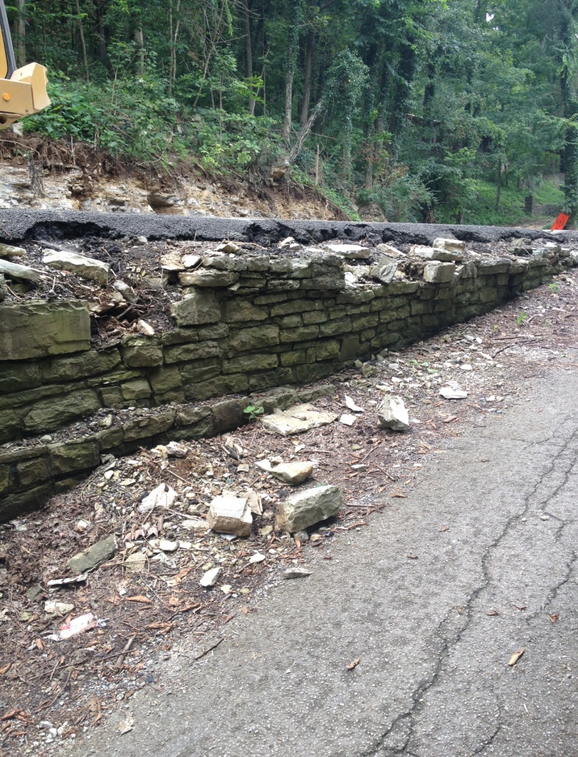
Project Improvements
4. Guardrail Improvement
Notes:
Guardrails were substandard by just a few inches so we are replacing to standard heights along with reestablishing the shoulders.

Slide 58
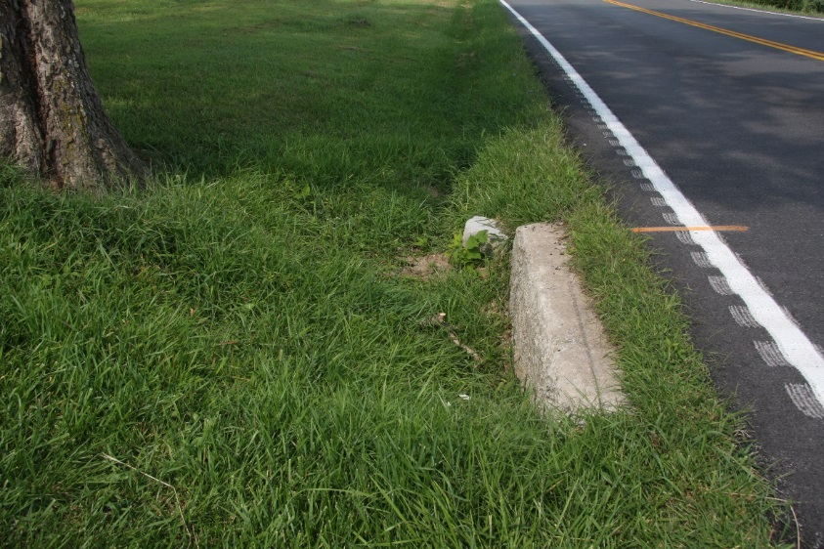
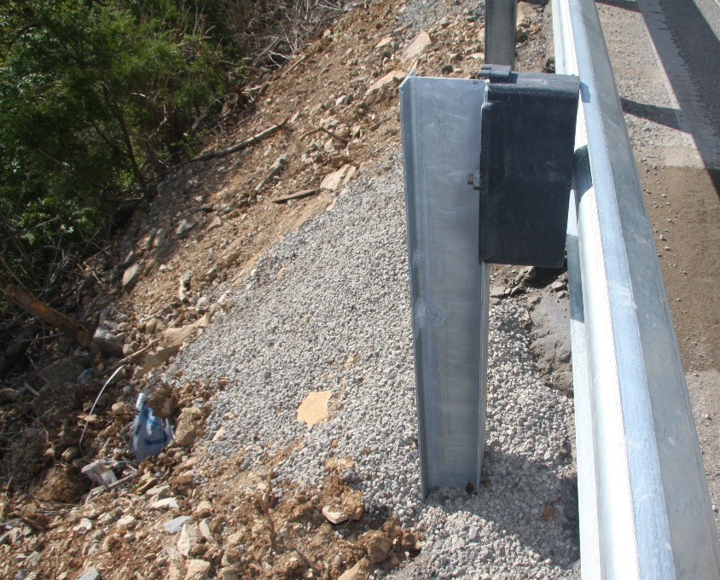
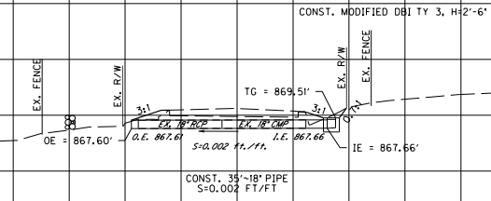
Project Improvements
6. Pipe Extensions
7. Pipe Replacements
Notes:
In order to eliminate the pipes and headwalls, As part of the outcome of improving ditches and shoulders, is the extending or replacement of cross drains to add a few more inches of length in with appropriate safety boxes when ROW allowed a sufficient width to do so.

Slide 59
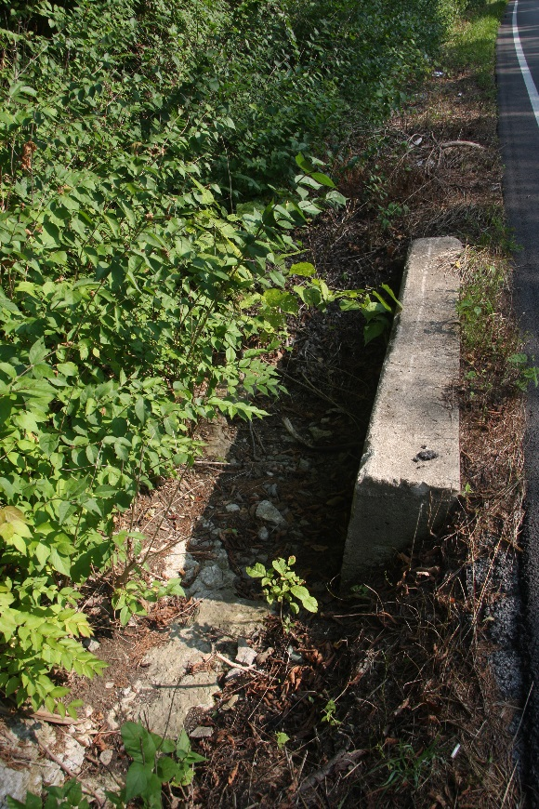
8. Drop Box Inlets
Modified
Before
After
Notes:
Locations were ROW is not sufficient for standard DBI’s, a modified DBI’s are being constructed through field design based on actual available area and height. The main intent is to not leave a drop off at inlets that could create issues if a tire dropped off the road.

Slide 60
Project Improvements
9. Tree Removal
10. Tree Canopy Cut
Before
After
Notes:
The tree canopy is cleared to a minimum of 35’ above the road and 5’ off each side let more sun light in.

Slide 61
Project Improvements
Tree Canopy Shading The Roadway
Notes:
The tree canopy shaded much of the roadway resulting in wet pavement most of the year and resulted in faster pavement deterioration and SNIC challenges.

Slide 62
Project Improvements
After
Before
Notes:
More tree canopy removal..

Slide 63
Questions?

